Slide 1
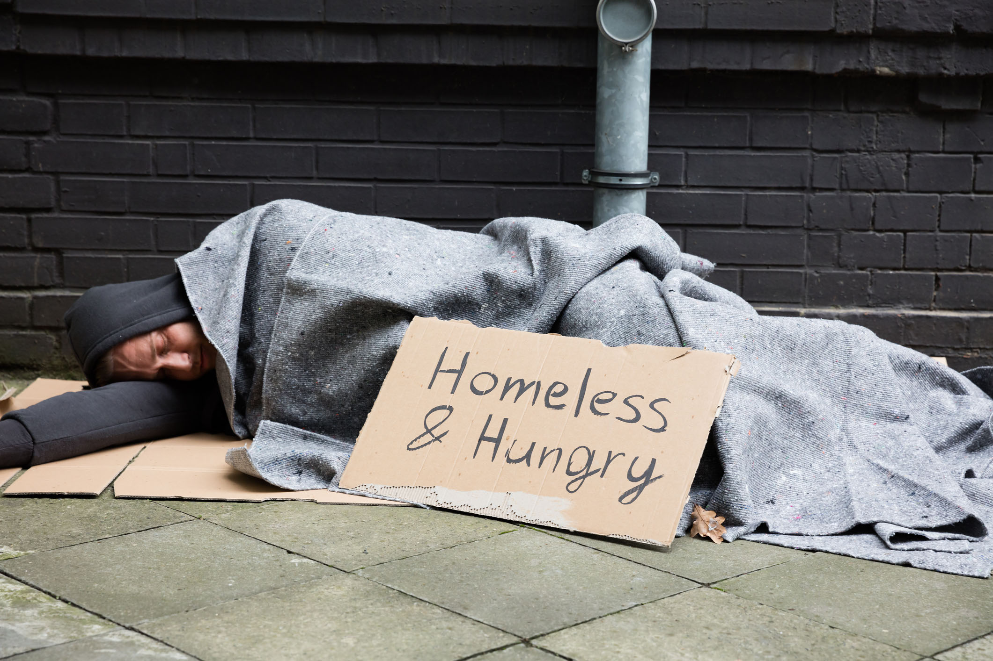
Homelessness: a primer for business
www.tricitieshomelessness.ca

Slide 2
Agenda
Understanding homelessness
Responding to problematic behaviour
Resources for persons homeless in the Tri-Cities
Sharps disposal
Panhandling and trespass
When to call for help
Review: key points
Dialogue session

Slide 3
Understanding homelessness
Why do people become homeless?
What does the world look like to someone who is homeless?
What do people who are homeless need?
Tri-Cities numbers

Slide 4
Understanding homelessness

Slide 5
Responding to problematic behaviour inside or outside a place of business
Do’s and don’ts
Role play scenarios
Scripts

Slide 6
Sample Scripts
Person inside with no intent to purchase
  “Can I help you?”
  “This store is for customers. We would appreciate if you would leave”
  Step back and wait. If the person does not conform: “If you don’t leave, I will need to call 911”
Person loitering or panhandling outside
  “Do you need help?” (offer a copy of the Tri-Cities Street Survival Guide”)
  “I am concerned that customers will be discouraged from coming inside. We would appreciate if you would move to another location”
Person inside high or acting strangely
  “Are you okay? You don’t look too good, I am going to get someone here to help you” (call 911)

Slide 7
Resources for persons homeless in the Tri-Cities
What is available?
What is missing?

Slide 8
Sharps disposal
Whom to call
Self-disposal

Slide 9
Panhandling and Trespass
Why do people panhandle?
How to respond to panhandling
Aggressive panhandling (Safe Streets Act)
Trespass Act

Slide 10
When to call for help
Call police non-emergency if:
  A property crime is being or has been committed, including violations of the Safe Streets or Trespass Act
Call 911 emergency if:
  You fear there is imminent danger to your own or someone else’s safety
  There appears to be a serious medical issue
CPETD

Slide 11
Key points
Homelessness is a symptom, not a lifestyle
Persons who become street-entrenched typically feel shunned and invisible
Persons who are homeless need a variety of supports in a non-judgemental and supportive environment.
Primary resources for persons homeless in the Tri-Cities:
  outreach workers
  24/7 low barrier emergency shelter facility at 3030 Gordon Ave
  overnight mat-based shelter during the winter months
What is needed most:
  affordable rental housing
  supportive housing
  strengthened mental health and addiction treatment services
Notes:
Homelessness is a symptom, not a lifestyle. Factors that can lead to homelessness include personal factors such as trauma, health issues or problematic relationships, and societal factors such as lack of affordable housing or insufficient income.
Persons who become street-entrenched typically feel shunned and invisible.
Persons who are homeless need a variety of supports in a respectful, non-judgemental and supportive environment. Expressions of anger, blame and contempt from the public will simply reinforce social alienation.
Primary resources for persons homeless in the Tri-Cities include outreach workers, a 24/7 low barrier emergency shelter facility at 3030 Gordon Ave, and an overnight mat-based shelter during the winter months.
What is needed: affordable rental housing, supportive housing, strengthened mental health and addiction treatment services

Slide 12
Key points
Do’s and don’ts of dealing with problematic behaviour:
  If a colleague is available, ask them to monitor the interaction from the background
  Approach the person from the front
  Keep your posture relaxed and maintain a safe distance from the person
  Greet the person respectfully, with a smile
  Ask if you can help them, ask what they need (provide with a copy of the Tri-Cities Street Survival Guide)
  Listen to the person - without judgement.
  If a person is extremely agitated or high, do not make eye contact
  Less words are more effective, keep your voice low, quiet and calm. Speak slowly
  Do not attempt to counsel
  Never attempt to physically restrain a person
Notes:
Do’s and don’ts
If a colleague is available, ask them to monitor the interaction from the background
Approach the person from the front
Keep your posture relaxed and maintain a safe distance from the person
Greet the person respectfully, with a smile
Ask if you can help them, ask what they need (provide with a copy of the Tri-Cities Street Survival Guide)
Listen to the person - without judgement.
If a person is extremely agitated or high, do not make eye contact
Do not attempt to counsel
Less words are more effective, keep your voice low, quiet and calm. Speak slowly
Never attempt to physically restrain a person

Slide 13
Key points
Sharps disposal - Contact the Purpose Society mobile health van 604-351-1885 for needle recovery and disposal, or self-dispose per FHA instructions
Panhandling, unless it is deemed aggressive or soliciting a captive audience, is not illegal. Deciding whether to give or not is a personal decision.
Call police non-emergency if:
  A property crime is being or has been committed, including violations of the Safe Streets or Trespass Act
Call 911 emergency if:
  You fear there is imminent danger to your own or someone else’s safety
  There appears to be a serious medical issue
Notes:
Sharps disposal - Contact the Purpose Society mobile health van 604-351-1885 for needle recovery and disposal or self-disposal per FHA instructions
Panhandling, unless it is deemed aggressive or soliciting a captive audience, is not illegal, and deciding whether to give or not is a personal decision.
Call 911 Police if:
You fear for your or someone else’s personal safety
A situation is escalating and you don’t feel you can handle it
A crime is being or has been committed, including a violation of the Safe Street or Trespass Acts

